Slide 1
Principles of Spectral Imaging
光谱成像原理

Slide 2
单点光谱扩展到光谱成像
From Single‑Point Spectroscopy to Spectral Imaging
Three Primary Spectral‑Imaging Acquisition Modes
光谱成像的主要模式
光谱分辨率与空间分辨率及其权衡
Trade‑off Between Spatial Resolution and Spectral Resolution
多光谱与高光谱
Multispectral and hyperspectral

Slide 3
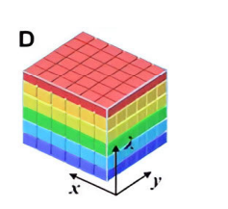
From Single‑Point Spectroscopy to Spectral Imaging
Conventional single‑point spectroscopy only obtains spectral information at one fixed spatial location: it answers “what” material the target is.
- Traditional 2‑D imaging only records spatial information: it answers “where” the object is located.
- Spectral imaging combines spectroscopy and imaging, generating a 3‑D spectral data cube I(x,y,λ). It answers: where is what.
- The data cube contains two spatial dimensions (x,y) and one spectral dimension (λ).
FIGURE 1. 3-D data cube [1]

Slide 4
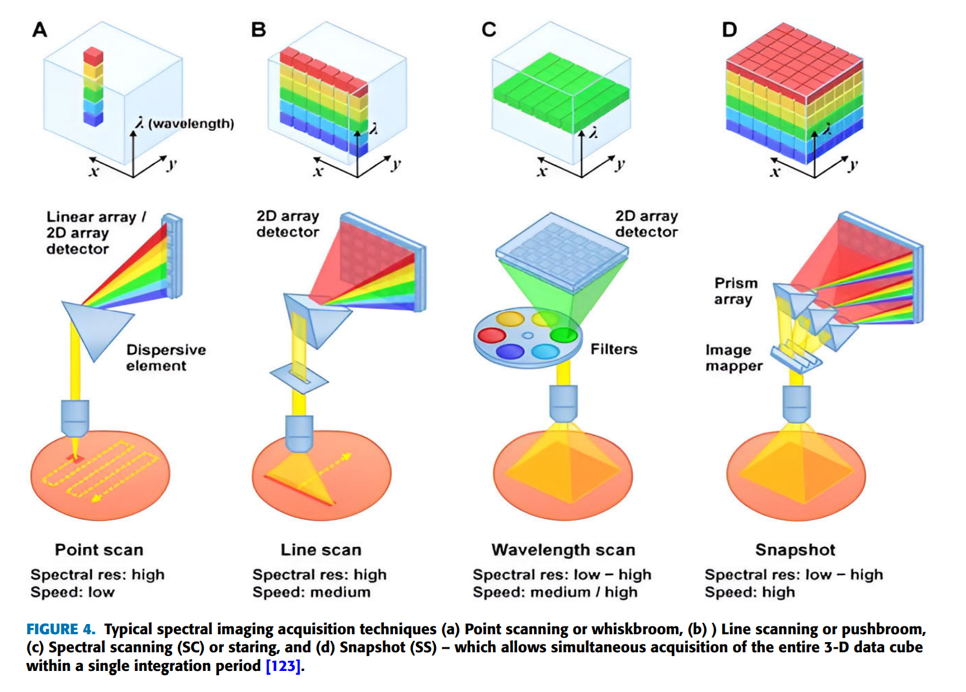
Whiskbroom Mode (Point‑Scanning，扫帚式 / 点扫描)
Optical path: Scanning mirror moves across scene, one spatial point at a time. Each single point acquires its complete full spectrum. Build cube by scanning every pixel point‑by‑point.
✅ Pros: High spectral quality for each sampled point; good SNR.
❌ Cons: Two‑axis mechanical scanning; long acquisition time; moving‑part artifacts.
Pushbroom Mode (Line‑Scanning，推扫式 / 线扫描)
Optical path: Simultaneously captures an entire line of spatial information plus full spectrum for each pixel on that line. Complete 2‑D spatial area is obtained via relative platform motion (aircraft / satellite / translation stage).
✅ Pros: Much faster than whiskbroom; widely used in remote sensing.
❌ Cons: Depends on steady relative movement between sensor and target.
FIGURE 2. (a) Point scanning or whiskbroom,
(b) Line scanning or pushbroom [1]

Slide 5
Staring Mode (Spectral Scanning，凝视式 / 光谱扫描)
Optical path: Keep the whole scene stationary on detector; use tunable optical filters (AOTF, LCTF, FPI, LVF) to sequentially select one wavelength band. Stack series of 2‑D images to reconstruct the full 3‑D data cube.
✅ Pros: Captures full‑field scene for each wavelength; no spatial mechanical scanning.
❌ Cons: Wavelength scanning takes time; poor performance for dynamic moving scenes.
FIGURE 3. (c)Spectral scanning (SC) or staring [1]

Slide 6
Trade‑off Between Spatial Resolution and Spectral Resolution
- In conventional spectral‑imaging optical systems, there exists an intrinsic trade‑off between spatial resolution and spectral resolution [1].
- Higher spectral resolution requires more, narrower spectral bands. Under limited photon budget and detector constraints, this often sacrifices spatial sampling performance.
- If you pursue fine spatial details (high spatial resolution), the number of available spectral channels will be limited.
- Advanced approaches such as snapshot imaging and compressive computational imaging can mitigate this conflict, but cannot completely eliminate the fundamental physical limits from photon availability.

Slide 7
MULTISPECTRAL IMAGING
多光谱成像
By capturing and analyzing how objects reflect, absorb, or emit light across different spectral bands, MSI uncovers information about the composition, structure, and properties of a scene or object. [1]
通过捕捉和分析物体在不同光谱带中反射、吸收或发射光的方式，多光谱成像（MSI）能够揭示场景或物体的组成、结构和特性信息。

Slide 8
HYPERSPECTRAL IMAGING
高光谱成像
While MSI systems have long provided a balance between spectral information and ease of implementation, the HSI systems have pushed the boundaries in terms of providing deep spectral insight.[1]
虽然多光谱成像（MSI）系统长期以来一直在光谱信息与实施便捷性之间寻求平衡，但高光谱成像（HSI）系统在提供深入的光谱洞察方面则突破了界限。

Slide 9
HYPERSPECTRAL IMAGING
高光谱成像
The pros of using Hyperspectral Imaging in different applications such as agriculture, and food quality estimation are as follows [2]:
(i) It is a non-invasive, non-contact, non-destructive technology that ensures the quality and safety of food goods.
(ii) The experiments use no chemicals therefore environmentally safe.
(iii) The time required to process for quality evaluation and food control/storage is low compared to chemical and traditional approaches.
(iv) It gives an improved understanding of the chemical elements of food products and is generally known as chemical imaging.
(v) It provides appropriate area selection for critical analysis of the image.
(vi) It gains spatial and spectral information together to provide more appropriate and accurate data concerning chemical samples from interested platforms and enhance a chance to data refine and achieve further experiments.

Slide 10
HYPERSPECTRAL IMAGING
高光谱成像
Despite its pros, Hyperspectral Imaging also has some cons [2].
(i) A hyperspectral imaging system is highly costly compared to other image processing techniques.
(ii) Since the data size of hyperspectral imaging is large, there is a demand for high-speed computers for the processing of data and extensive capacity drives for the storage of data.
(iii) While acquiring the images, the signal could be impacted by ambient surroundings such as scattering, illumination, etc. therefore producing a destitute signal-to-noise ratio.
(iv) Detection and identification of different items within the equivalent image using spectral data is mostly difficult except the diverse objects have distinct absorption features.

Slide 11
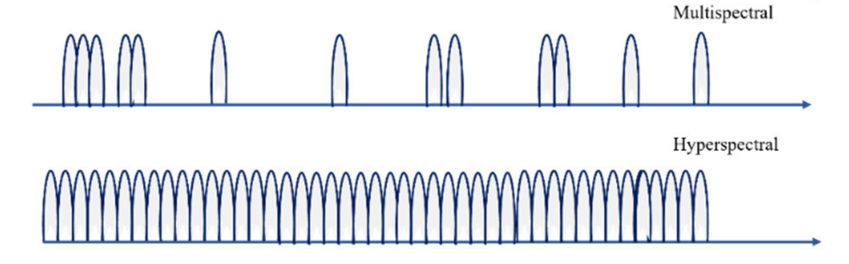
Multispectral Imaging VS Hyperspectral Imaging
 | Multispectral Imaging 多光谱成像 | Hyperspectral Imaging 高光谱成像
Spectral bands 光谱波段 | Discrete widely‑spaced bands (typically 3‑25 bands) | Hundreds of contiguous narrow spectral bands
Spectral signature 光谱特征 | Coarse spectral sampling | Dense continuous spectral fingerprint per pixel
Data volume 数据量 | Small, easy to process | Large 3‑D data cube heavy computation load
Typical strength 优势 | Higher spatial / temporal resolution; low cost | Fine material discrimination by continuous spectrum

Slide 12
论文引用
[1] Mukhtar, S., Arbabi, A., & Viegas, J. (2025). Advances in Spectral Imaging: A Review of Techniques and Technologies. IEEE Access, 13, 35848‑35902. https://doi.org/10.1109/ACCESS.2025.3544476
[2] Guolan Lu, Baowei Fei, Medical hyperspectral imaging: a review, J. Biomed. Opt. 19 (1) (20 January 2014) 010901, https://doi.org/10.1117/1. JBO

